Slide 1
Sweden´s development assistance for health Gavin Yamey and Marco Schäferhoff Seminar on development assistance for health March 19, 2015 Stockholm, Sweden

Slide 2
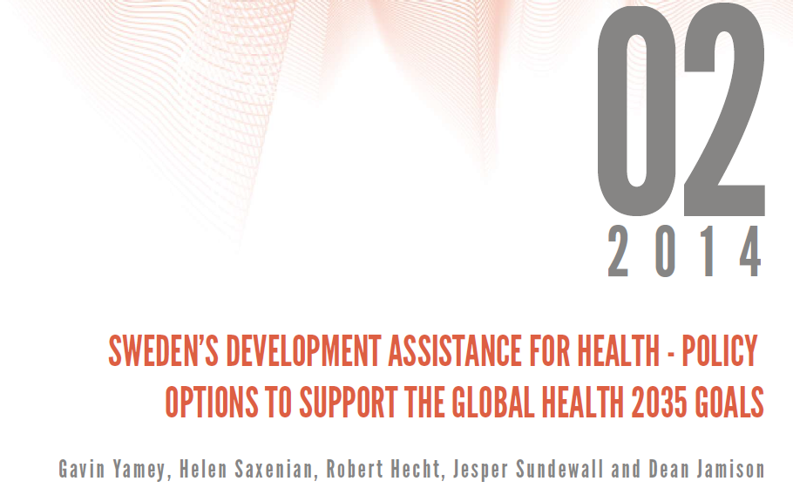
Gavin Yamey
Associate Professor of Epidemiology & Biostatistics, UCSF School of Medicine
Lead, Evidence to Policy Initiative, Global Health Group, UCSF
March 19, 2015
Stockholm, Sweden

Slide 3
Our Approach
1. Summarize GH2035 and implications for DAH
2. Lay out key post-2015 global health challenges and opportunities
3. Develop new classification of DAH by function
5. Assess Sweden’s strengths & impacts in global health
6. Policy options for Swedish DAH to support GH2035 goals—based on strengths and neglected functions
4. Analyze Swedish DAH by function

Slide 4
Our Approach
1. Summarize GH2035 and implications for DAH
2. Lay out key post-2015 global health challenges and opportunities
3. Develop new classification of DAH by function
5. Assess Sweden’s strengths & impacts in global health
6. Policy options for Swedish DAH to support GH2035 goals—based on strengths and neglected functions
4. Analyze Swedish DAH by function

Slide 5
Global Health 2035: Key Findings
For infectious, maternal & child deaths, a grand convergence is possible by 2035
The returns from investing in convergence are impressive
DAH is likely to shift away from supportive towards core functions
Fiscal policies are a powerful, underused lever for curbing non-communicable diseases and injuries
Pro-poor pathways to UHC could efficiently achieve health & financial protection

Slide 6
DAH Needs to Shift Towards Core Functions
Function | Key Examples
Core: Providing global public goods | ▪ R&D for health tools ▪ Knowledge generation and sharing ▪ Intellectual property and market shaping activities
Core: Controlling cross-border externalities | ▪ Surveillance, information sharing, regulatory regimes e.g. to tackle cross-border outbreaks, counterfeit drugs, antibiotic resistance, tobacco marketing
Core: Leadership and stewardship | ▪ Global health advocacy, priority setting, aid effectiveness
Supportive: Direct country assistance | ▪ Financial and technical assistance
Jamison DT, Frenk J, Knaul F. International collective action in health: objectives, functions, and rationale. Lancet 1998; 351: 514–17.

Slide 7
Our Approach
1. Summarize GH2035 and implications for DAH
2. Lay out key post-2015 global health challenges and opportunities
3. Develop new classification of DAH by function
5. Assess Sweden’s strengths & impacts in global health
6. Policy options for Swedish DAH to support GH2035 goals—based on strengths and neglected functions
4. Analyze Swedish DAH by function

Slide 8
Our Approach
1. Summarize GH2035 and implications for DAH
2. Lay out key post-2015 global health challenges and opportunities
3. Develop new classification of DAH by function
5. Assess Sweden’s strengths & impacts in global health
6. Policy options for Swedish DAH to support GH2035 goals—based on strengths and neglected functions
4. Analyze Swedish DAH by function

Slide 9
Post-2015 Challenges/Opportunities
1. Unfinished MDGs agenda
2. Microbial evolution
For infectious, maternal & child deaths, a grand convergence is possible by 2035
The returns from investing in convergence are impressive
DAH is likely to shift away from supportive towards core functions
Fiscal policies are powerful, underused lever for curbing NCDs & injuries
Pro-poor UHC could efficiently achieve health & financial protection
3. Crisis of NCDs and injuries
4. Medical impoverishment
5. International collective action arrangements and financing are not “fit for purpose”

Slide 10
Our Approach
1. Summarize GH2035 and implications for DAH
2. Lay out key post-2015 global health challenges and opportunities
3. Develop new classification of DAH by function
5. Assess Sweden’s strengths & impacts in global health
6. Policy options for Swedish DAH to support GH2035 goals—based on strengths and neglected functions
4. Analyze Swedish DAH by function

Slide 11
Our Approach
1. Summarize GH2035 and implications for DAH
2. Lay out key post-2015 global health challenges and opportunities
3. Develop new classification of DAH by function
5. Assess Sweden’s strengths & impacts in global health
6. Policy options for Swedish DAH to support GH2035 goals—based on strengths and neglected functions
4. Analyze Swedish DAH by function

Slide 12
Policy-oriented DAH framework
Function | Type of DAH | Definition | Example
Core functions: GPGs, cross-border externalities, leadership | Global | Funding to address global issues | R&D of new health tools
 | Local plus | Funding to a LIC/MIC for core functions disbursed at country level | DAH to a country to support regional malaria elimination
Country-specific support | Local | Fungible aid to a LIC/MIC that could be easily replaced with domestic financing as countries get richer | DAH to support the purchase of health commodities or to pay health workers to deliver MNCH services
 | Special Local Support (SLS) | Funding for vulnerable groups and politically problematic services | DAH for displaced persons; DAH for family planning

Slide 13
Our Approach
1. Summarize GH2035 and implications for DAH
2. Lay out key post-2015 global health challenges and opportunities
3. Develop new classification of DAH by function
5. Assess Sweden’s strengths & impacts in global health
6. Policy options for Swedish DAH to support GH2035 goals—based on strengths and neglected functions
4. Analyze Swedish DAH by function

Slide 14
Our Approach
1. Summarize GH2035 and implications for DAH
2. Lay out key post-2015 global health challenges and opportunities
3. Develop new classification of DAH by function
5. Assess Sweden’s strengths & impacts in global health
6. Policy options for Swedish DAH to support GH2035 goals—based on strengths and neglected functions
4. Analyze Swedish DAH by function

Slide 15
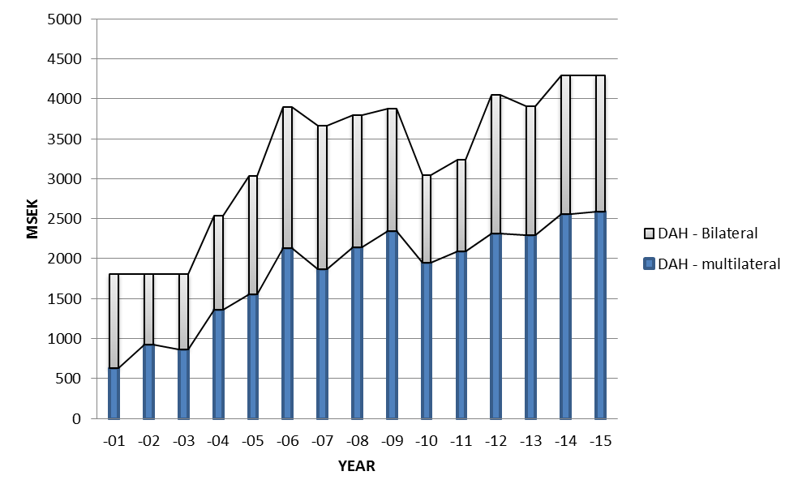
Swedish DAH Reached About 4 Billion SEK in 2013
1.6 billion SEK in 2013
2.3 billion SEK in 2013
GFATM | 0.7
UNFPA | 0.43
GAVI | 0.37

Slide 16
Our Analysis of Swedish DAH by Function
80% country-specific support 20% core functions
85% of Swedish DAH is for country-specific support
89% country-specific support
11% core functions

Slide 17
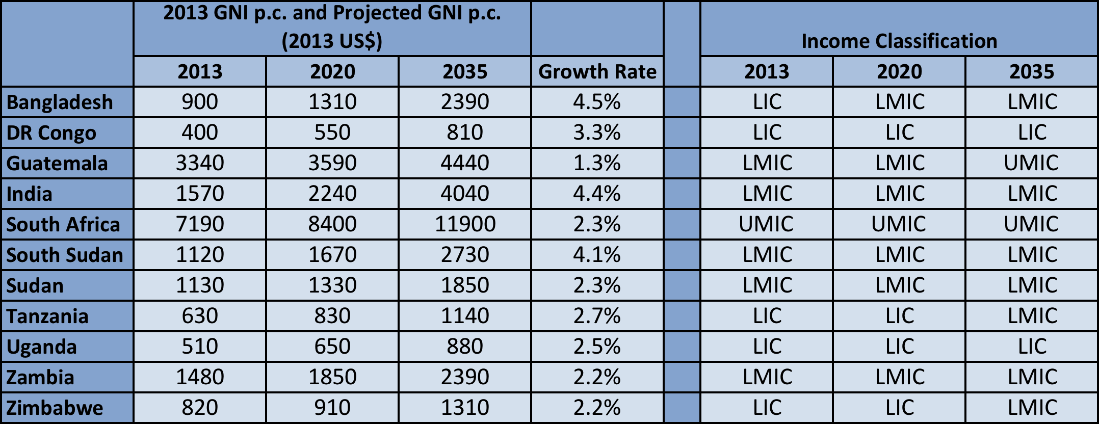
Economic Growth Means Some Countries May Graduate from Swedish DAH by 2035
Example: applying GAVI graduation cut-off of $1570 p.c., only 4 countries would be eligible for Swedish support

Slide 18
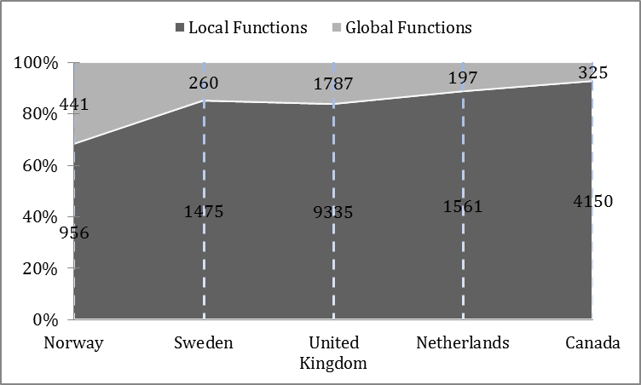
Dominance of Funding for Local Functions is True for Bilateral DAH of Other Donors

Slide 19
Our Approach
1. Summarize GH2035 goals and implications for DAH
2. Lay out key post-2015 global health challenges and opportunities
3. Develop new classification of DAH by function
5. Assess Sweden’s strengths & impacts in global health
6. Policy options for Swedish DAH to support GH2035 goals—based on strengths and neglected functions
4. Analyze Swedish DAH by function

Slide 20
Our Approach
1. Summarize GH2035 goals and implications for DAH
2. Lay out key post-2015 global health challenges and opportunities
3. Develop new classification of DAH by function
5. Assess Sweden’s strengths & impacts in global health
6. Policy options for Swedish DAH to support GH2035 goals—based on strengths and neglected functions
4. Analyze Swedish DAH by function

Slide 21
Global Health is a Core Priority for Swedish Aid: Active, Visible, Influential Health Donor
Sexual and reproductive health and rights, including family planning and safe abortion
Midwifery, e.g. major support to UNFPA for midwifery programs
Growing reputation and expertise on NCDs and injuries, including road traffic safety
Antibiotic resistance; research on infections of poverty (only about 200 million SEK per y)

Slide 22
Growth in Swedish DAH by 2035
Notes:
We argue that a greater % of ODA should go to health. Why? First, health aid has a strong record of exceptional implementation success, as shown for example by the robust association between development assistance for health for scaling up HIV and malaria control tools and reduced mortality from these infections. Second, the returns to investing in the health sector have historically been very large—benefit-cost analyses can be around 5-10 or even higher

Slide 23
Our Approach
1. Summarize GH2035 and implications for DAH
2. Lay out key post-2015 global health challenges and opportunities
3. Develop new classification of DAH by function
5. Assess Sweden’s strengths & impacts in global health
6. Policy options for Swedish DAH to support GH2035 goals—based on strengths and neglected functions
4. Analyze Swedish DAH by function

Slide 24
Our Approach
1. Summarize GH2035 and implications for DAH
2. Lay out key post-2015 global health challenges and opportunities
3. Develop new classification of DAH by function
5. Assess Sweden’s strengths & impacts in global health
6. Policy options for Swedish DAH to support GH2035 goals—based on strengths and neglected functions
4. Analyze Swedish DAH by function

Slide 25
Overarching Policy Considerations
Invest in high priority core functions, avoid sudden shifts, be synergistic with other sectors
When providing country-specific support, direct SEK to countries below agreed threshold (e.g. IDA eligibility)
In supporting “local plus” and “special local support” functions, assess fungibility as criterion for SEK: can function be funded domestically?
For local, “local plus,” and “special local support,” couple SEK with dialogue to influence policy change

Slide 26
Reminder: Five Major Post-2015 Challenges/Opportunities
1. Unfinished MDGs agenda
2. Microbial evolution
For infectious, maternal & child deaths, a grand convergence is possible by 2035
The returns from investing in convergence are impressive
DAH is likely to shift away from supportive towards core functions
Fiscal policies are powerful, underused lever for curbing NCDs & injuries
Pro-poor UHC could efficiently achieve health & financial protection
3. Crisis of NCDs and injuries
4. Medical impoverishment
5. International collective action arrangements and financing are not “fit for purpose”

Slide 27
Examples of Policy Options
Post-2015 Challenge
Sweden’s strengths
Opportunities
Unfinished MDGs agenda (achieving convergence)
Antimicrobial evolution
Crisis of NCDs/injuries
Support for infectious disease research (including HIV vaccine/microbicides)
World leader in control of antimicrobial resistance
Spends increasing political capital on advocacy for NCDs; world leader on road injuries
Local plus: Build national capacity to conduct I.D. research of global value (e.g. scale-up methods)
Global: fund coalition to ramp up surveillance & control of AMR
Local plus: Build national capacity to conduct NCD research of global value (e.g. PPIR)

Slide 28
Classifying DAH by functions helps articulate roles of DAH post-2015
Swedish DAH mostly targets local functions
Some countries may graduate from Swedish DAH by 2035
Sweden can play a key role in tackling the 5 key post-2015 challenges, given its impacts/strengths in global health
Significant additional Swedish DAH likely to be available from 2015 to 2035
Investing this additional Swedish DAH in specific global, local, “local plus” and “special local support” functions could help reach the GH 2035 goals

Slide 29
Commission on Investing in Health: DAH Framework and Analysis – Preliminary Results
Marco Schäferhoff, PhD
Associate Director, SEEK Development
Health Network Seminar, SIDA
Stockholm, March 19, 2015

Slide 30
Content
Evolution of DAH Framework
Preliminary findings for Sweden
Donor comparison
Initial conclusions

Slide 31
Initial CIH classification of DAH by function
Function | Key Examples
Core: Providing global public goods (GPGs) | ▪ R&D for health tools ▪ Knowledge generation and sharing ▪ Intellectual property and market shaping activities
Core: Controlling cross-border externalities | ▪ Surveillance, information sharing, regulatory regimes e.g. to tackle cross-border outbreaks, counterfeit drugs, antibiotic resistance
Core: Leadership and stewardship | ▪ Convening for negotiation and consensus building; consensus building on policy; advocacy
Supportive: Direct country assistance | ▪ Financial and technical assistance
Jamison DT, Summers L, Alleyne G, et al. Global health 2035: a world converging within a generation (2013). The Lancet; Volume 382, Issue 9908 : 1898-1955.
Notes:
Categories 1-3 of DAH underfunded

Slide 32
As their income grows, countries are increasingly able to replace supportive DAH with domestic spending
Positive
Core functions
Development continuum
Established market economies
Industrialised
countries in transition
Advanced developing countries
Other developing countries
Countries in crisis
Supportive functions
Negative
Jamison DT, Frenk J, Knaul F. International collective action in health: objectives, functions, and rationale. Lancet 1998; 351:514–17.
Notes:
Supportive functions should be seen as temporary assistance limited to resource-poor populations and countries with special needs. As countries grow richer, supportive functions should gradually become the responsibility of national governments and international collective action should focus its attention on core functions.

Slide 33
Evolution of the DAH framework
CIH Report 2013
Core functions: GPGs; management of externalities; leadership and stewardship
Supportive function: direct country assistance
ICA 2014
Advanced concept and additional data collection
CIH Phase 3
Glocal DAH: DAH channeled to countries benefitting core functions, plus support for vulnerable populations and politically problematic services (no data collection)
Policy-oriented framework with advanced distinctions and significant data collection
Deconstructs glocal DAH by distinguishing between (a) funding to countries with global implications and (b) funding for vulnerable populations and politically problematic services
Local DAH: fungible aid to LICs/MICs that could be replaced with domestic financing
Broad distinction between core and supportive function and limited data collection
Significant data collection for each targeted donor
Differentiates between funding for global functions and country-specific funding
Global DAH: addresses global and transnational issues;
Notes:
The simple dichotomy of international collective action into core and supportive is useful for a broad categorization of health aid according to functions. However, the categories of core and supportive fail to capture the types of direct country assistance (i.e. supportive DAH) that (a) have an element of international collective action, and (b) may not be easily replaced by domestic financing when LICs and LMICs become wealthier.
Largest share of the poor live in MICs. DAH also needed especially for vulnerable groups and politically problematic services even when countries graduate to middle-income status

Slide 34
Policy-oriented DAH framework
Function | Type of DAH | Definition | Example
Core functions: GPGs, cross-border externalities, leadership | Global | Funding to address global issues | R&D of new health tools
 | Local plus | Funding to a LIC/MIC for core functions disbursed at country level | DAH to a country to support regional malaria elimination
Country-specific support | Local | Fungible aid to a LIC/MIC that could be easily replaced with domestic financing as countries get richer | DAH to support the purchase of health commodities or to pay health workers to deliver MNCH services
 | Special Local Support (SLS) | Funding for vulnerable groups and politically problematic services | DAH for displaced persons; DAH for family planning

Slide 35
Added value of policy-oriented DAH framework
Type of assessment
Added Value
Estimates funding for global functions disbursed at country level (‘local plus’) |  | Provides a more accurate and comprehensive picture: there is more funding for global functions than previously estimated
Assesses funding for vulnerable populations and FP (Special Local Support) |  | Contributes to the debate on graduating countries and enables targeted policy guidance
Analyzes domestic R&D spending |  | Better depicts overall donor support for global health
Notes:
And other types of global funding as well. Example: HSS funding may help to prevent infectious outbreaks – a clear contribution to a global public good.
R&D as a key area deserves special attention

Slide 36
Methodological approach
What’s Included:
Bilateral health ODA for 8 donors based on OECD-DAC’s CRS
2013 disbursements
Funding differentiation at both:
Global level (bilateral unspecified)
Country and regional levels
90% of bilateral DAH for each donor assessed
Multilateral funding
Assessment of donor funding for health R&D more broadly (domestic R&D funds)
Coding Process:
Guided by a codebook, and thus replicable
Iterative process:
Reviewed CRS project descriptions and manually coded projects according to (sub-)functions
Conducted internet research when further information was needed
For funding channeled through multilaterals, developed a breakdown for each organization and applied across all donors

Slide 37
Assessed sub-functions
Function | Sub-functions
Providing global public goods | R&D for health tools Development/harmonization of int. health regulations Knowledge generation and sharing Intellectual property Market shaping activities
Controlling cross-border externalities | Outbreak preparedness and response Responses to antimicrobial resistance Responses to marketing of unhealthful products Control of cross border disease movement
Providing leadership and stewardship | Health advocacy and priority setting Promotion of aid effectiveness and accountability
Country-specific support incl. SLS | Convergence support (general) Cross-cutting HSS and pooled funding NCDs and injuries SLS: Family planning and abortion services Support for vulnerable subpopulations
Notes:
Other

Slide 38
Our DAH analysis targets eight major donors
Australia
France
Germany
Netherlands
Norway
Sweden
UK
USA
DAH of seven major donors analyzed thus far

Slide 39
Content
Evolution of DAH Framework
Preliminary findings for Sweden
Donor comparison
Initial conclusions

Slide 40
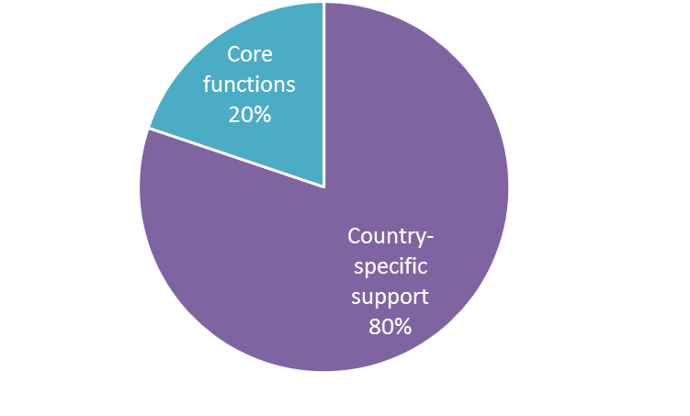
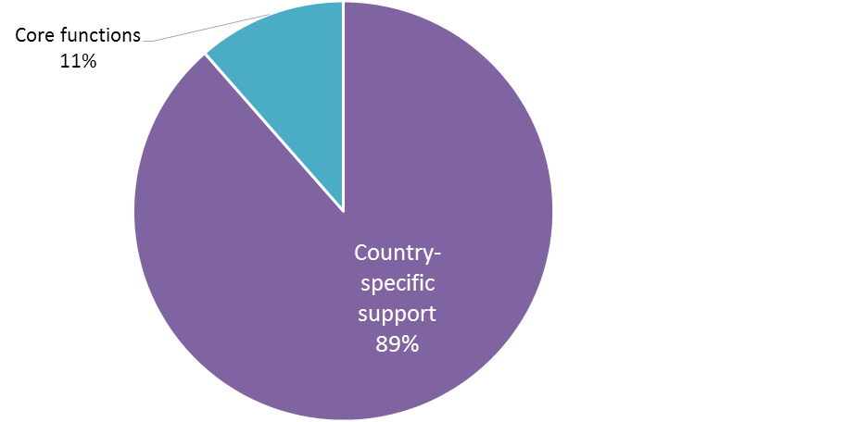
About 85% of Sweden’s DAH is country-specific support
Bilateral US$249 million*
85.4% of total DAH is for country-specific support
Sweden’s 2013 DAH
Multilateral US$384 million
* 91% of bilateral DAH has been assessed

Slide 41
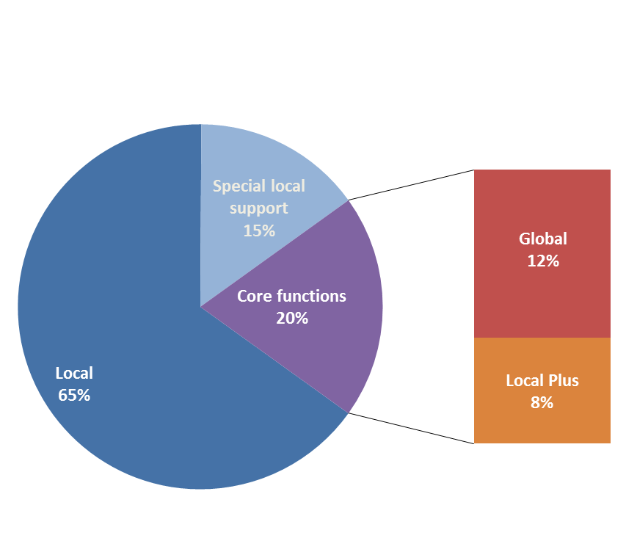
A fifth of Sweden’s bilateral DAH supports core functions
80% of Sweden’s DAH supports country-specific activities
20% of Swedish DAH supports core activities. Of this:
12% was disbursed as global
8% as local plus
Breakdown of Sweden's bilateral DAH by DAH type, 2013
Total = US$227 million
(91% of bilateral DAH has been assessed)

Slide 42
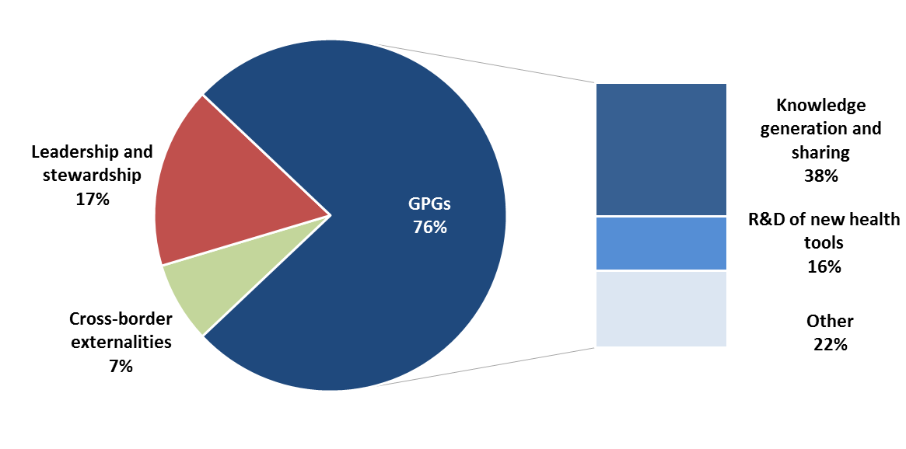
Core function support is heavily focused on supplying GPGs
Breakdown of Sweden's bilateral DAH for core functions, 2013
Total = US$45 million
(91% of bilateral DAH has been assessed)
Notes:
Level of disbursement
Over a third of the funding for GPGs and leadership/stewardship is disbursed at country level
All funding to sharing of intellectual property is at global level
Funding for antimicrobial resistance is fully disbursed at country level

Slide 43
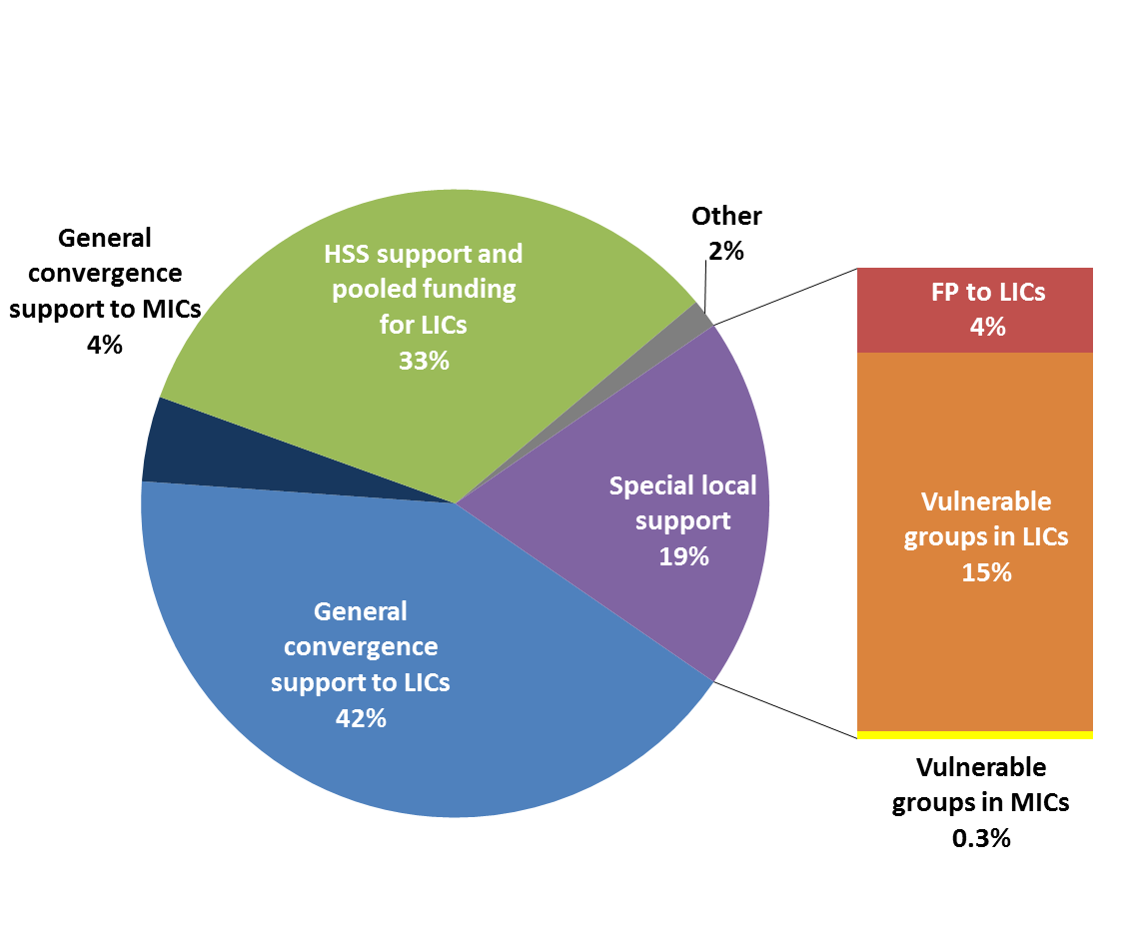
Vulnerable sub-populations receive significant attention
Breakdown of Sweden's bilateral DAH for country-specific support, 2013
46% of Sweden’s local support is directed to convergence
19% of local support is of special concern:
family planning (4%) and
targeting vulnerable populations (15%)
33% of local support is for cross-cutting HSS in LICs
Total: US$182 million
(91% of bilateral DAH has been assessed)

Slide 44
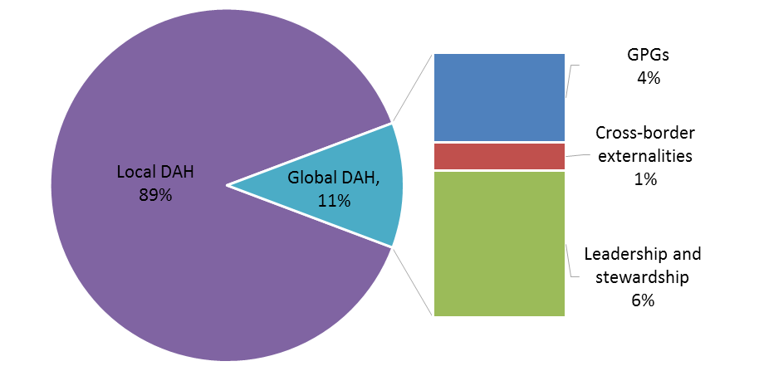
89% of multilateral funding is for country-specific support
Breakdown of Sweden's multilateral DAH by function, 2013
Includes core contributions to large health multilaterals:
Global Fund US$115 million
Gavi US$75 million
UNFPA US$66 million
UNAIDS US$38 million
WHO US$14 million
Notes:
GAVI+GF make a huge difference.

Slide 45
Content
Evolution of DAH Framework
Preliminary findings for Sweden
Donor comparison
Initial conclusions

Slide 46
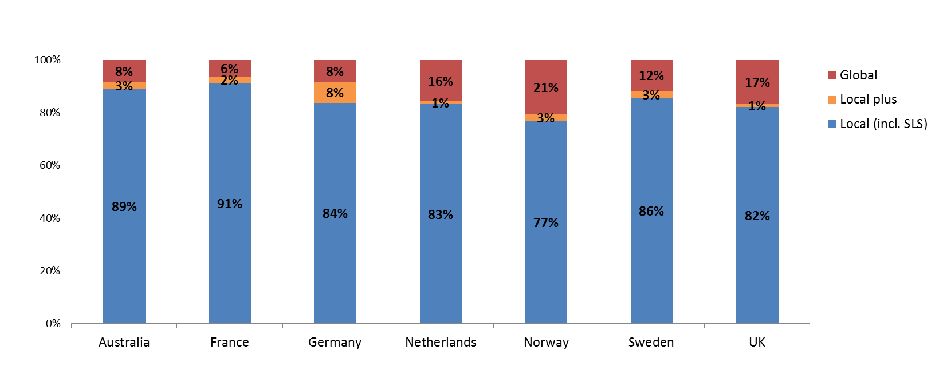
77-91% of total DAH is country-specific support
Total DAH funding across types, 2013 as a percentage of total DAH
Sweden’s investments to core functions and country-specific services are roughly equal in proportion to Germany
Norway invests most in global support (23%) and France least (9%)

Slide 47
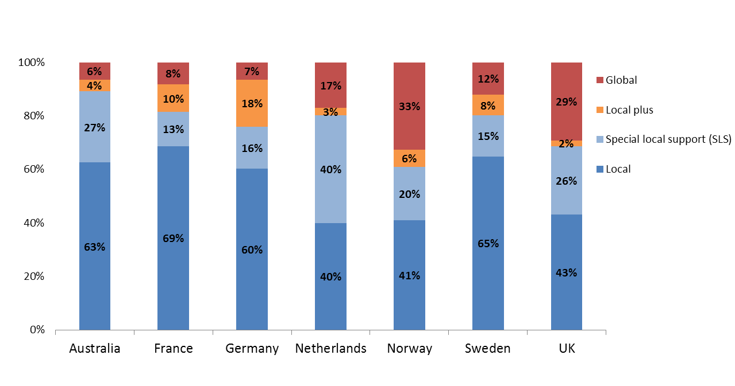
61-90% of bilateral DAH is for country-specific purposes
Bilateral DAH funding across types, 2013 as a percentage of total bilateral DAH
Sweden invests 20% of bilateral DAH in core functions, roughly the same as France and the Netherlands
Norway invests most in core functions (39%) and Australia least (10%)

Slide 48
Five of seven donors provide more than half or their core function to GPGs
Breakdown of bilateral support for core functions, 2013
 | % of bilateral health ODA devoted to core functions | Amount devoted to core functions | Breakdown of core functions (%)
 |  |  | GPGs | Managing externalities | Leadership or stewardship
Norway | 39.1% | 100.4 | 81.1% | 0.4% | 18.5%
UK | 31.3% | 540.1 | 42.5% | 53.6% | 3.9%
Germany | 24.1% | 106.7 | 36.8% | 53.8% | 9.3%
Sweden | 19.8% | 45.1 | 75.9% | 7.4% | 16.7%
Netherlands | 19.7% | 49.3 | 52.0% | 2.2% | 45.8%
France | 18.6% | 42.5 | 72.5% | 19.9% | 7.6%
Australia | 10.9% | 34.1 | 56.0% | 8.6% | 35.4%

Slide 49
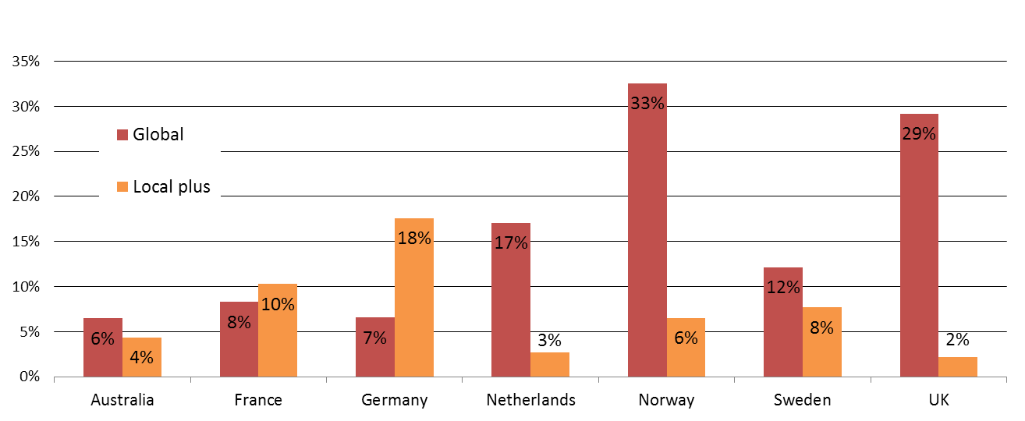
4 of 7 donors contributed most of their core function support through the global level, rather than through local plus
Core function funding at the country and global level, as a percentage of total bilateral DAH (2013)
Four of the seven donors, including Sweden, contributed most of their core function support through the global level, rather than through local plus
Countries like Norway and the UK invest heavily in core functions through the global level
Germany invests over 2x more in core functions through local plus disbursements than global
France supports core functions almost equally between global and local plus.
Notes:
Funding disbursed at both the global and country-level can support global core functions (GPGs, managing externalities, and leadership/stewardship)

Slide 50
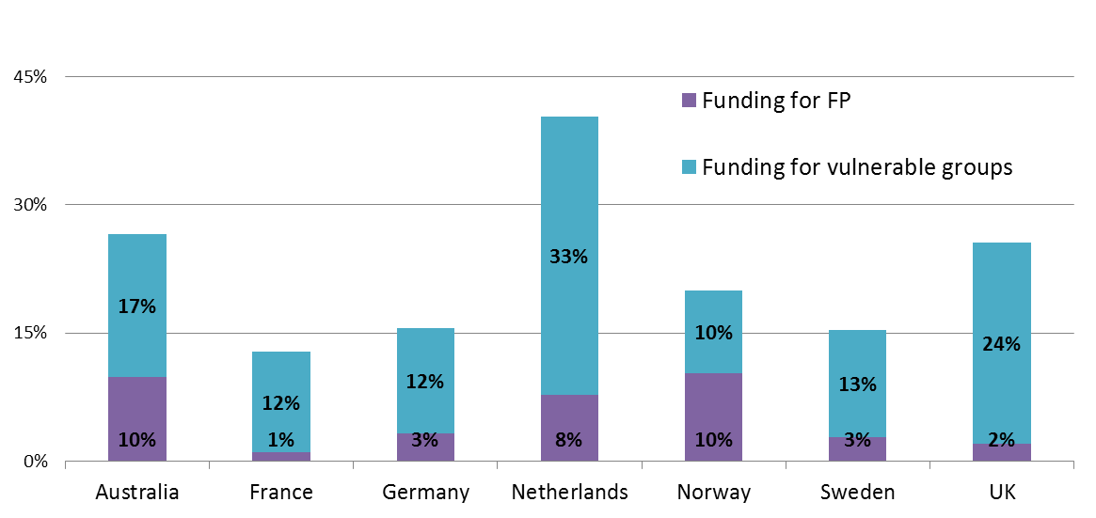
Between 13-41% of bilateral DAH is for special local support
Funding for special local support, 2013 as a percentage of total bilateral DAH
Notes:
Projects were allocated to these categories when there were explicit description of FP programs, abortion related services, or projects for marginalized, sex-workers, etc. communities

Slide 51
Content
Evolution of DAH Framework
Preliminary findings for Sweden
Donor comparison
Initial conclusions

Slide 52
Initial conclusions of our analysis
Our initial analysis
Confirms that the majority of funding is for country-specific purposes, with DAH allocated to core functions
Finds that there is especially limited attention to the management of externalities (YR 2013)
Shows that the share of DAH for ‘local plus’ funding differs between countries
Indicates that the support for vulnerable sub-populations and politically problematic services varies between donors

Slide 53
Thank You GlobalHealth2035.org
@gyamey
@globlhealth2035
#GH2035

Slide 54
Backup Slides

Slide 55
Examples from Sweden’s 2013 CRS
Function | Type of DAH | Example
Core functions | Global | WHO Research support: Sida supports WHO in its efforts to strengthen the knowledge base for the development of normative functions of the WHO and for coordinating, supporting and influencing global efforts to combat a portfolio of major diseases and conditions
 | Local Plus | Vietnam: Support to improve antibiotic use and contain resistance development in major Vietnamese hospitals through evidence based intervention
Country-specific support | Local | Zambia: Program to increase the number and quality of health personnel and strengthen systems for training supportive supervision and mentorship
 | Special Local Support (SLS) | DRC: Support to the Merlin Health Project, with the purpose to support a sustainable and accessible primary health care system for vulnerable populations in North Kivu and Maniema provinces, including the internally displaced, host populations and returnees

