Slide 1
Graduation of Ghana and Kenya to lower-middle income status: fiscal implications for health financing
School of Public Health, University of Ghana (GSPH)
The Lancet Commission on Investing in Health (CIH)

Slide 2
Background & Requirements for Convergence
Justice Nonvignon, PhD
School of Public Health
University of Ghana

Slide 3
Global Health 2035

Slide 4
Background
The graduation of Ghana (2010) and Kenya (2014) to lower-middle income country status came as good news:
Depicts growth in economic activity, affecting all sectors
Growth expected to lead to
Expansion in critical health infrastructure through improved health spending
Improvements in health outcomes / indicators
In reality, however, this may have downsides:
Reduction in total funds available to the sector due to reduction in donor support
If action not taken, may lead to shrinking infrastructure, worsening health outcomes

Slide 5
Objectives
The main objectives of the study were to:
Estimate funding requirements to achieve “grand convergence” in health
Explore funding gap due to reduced donor support
Explore potential fiscal space for health
Notes:
Grand convergence: CIH (chaired by Larry Sammers and Dean Jamison) estimates that with targeted investments in health, LICs and LMICs would see a reduction in the rates of infectious, child, and maternal deaths to the levels of the best performing middle-income countries (China, Costa Rica, Cuba, Chile); <100 per 100,000 maternal mortality; <15 per 1,000 for U5 mortality

Slide 6
Funding Requirements to Attain the Grand Convergence: Ghana & Kenya

Slide 7
Achieving GCH: Incremental Costs
KENYA
A total of $932m is required annually over 20 years (i.e total $18.6b) on top of current spending
About 83% of that for health systems str.
The rest distributed among prog areas
Investments should target vulnerable regions & populations with interventions
About 54,031 deaths could be averted each year
Econ returns could be $14 for every $1 spent i.e. BCR of >14.28
GHANA
Total of $566m annually over the next 20 years (i.e total $11.3b) on top of current spending to reach “grand convergence”)
About 82% of that for health systems str.
The rest distributed among prog areas
Investments should target vulnerable regions & populations with interventions
Cost savings could accrue in immunizations, TB
About 23,930 deaths could be averted each year
Econ returns could be $10 for every $1 spent i.e. BCR of >10.9

Slide 8
Distribution of Incremental Programmatic Costs

Slide 9
Estimated Reductions in Mortality
Kenya
Cause | 2011 (# of deaths) | 2035 (# of deaths) | % reduction
Maternal deaths | 5,700 | 1,900 | 67%
Stillbirths | 35,000 | 17,600 | 50%
Under-5 child deaths | 131,100 | 46,800 | 64%
TB deaths | 12,500 | 4,100 | 67%
HIV deaths | 71,000 | 11,100 | 84%
Births | 1,584,000 | 1,298,000 | 18%
Total fertility rate (births per woman) | 4.7 | 2.2 | 53%
Under-5 mortality rate (per 1,000 live births) | 83 | 36 | 57%
Ghana
Cause | 2015 (# of deaths) | 2035 (# of deaths) | % reduction
Maternal deaths | 4,200 | 2,600 | 42%
Under-5 child deaths | 71,900 | 25,200 | 65%
TB deaths | 14,700 | 1,000 | 93%
HIV deaths | 13,000 | 12,000 | 8%
Births | 807,700 | 705,000 | 13%
Total fertility rate (births per woman) | 4 | 2 | 50%
Under-5 mortality rate (per 1,000 births) | 61 | 36 | 41%

Slide 10
Ghana Case
Jacob Novignon, PhD
Economics Department
KNUST, Ghana

Slide 11
Funding Gap

Slide 12
Health Expenditure by Source, 2005 - 2013
Notes:
Budgeted donor support 22.2% in 2011 to 13.2% in 2016
Net ODA received per capita declined by 30% - from $72.6 in 2011 to $50.9 in 2013

Slide 13
Fiscal Space

Slide 14
Improved Tax Revenue
We assessed tax efforts, buoyancy and elasticity of various tax handles and conclude that there is space to broaden tax base and raise more revenue for health
Tax effort in Ghana is lower across such handles as (VAT, excise, corporate, income etc.). This raises efficiency concerns.
Average tax elasticity is estimated to be 1.03 between 1987 and 2007.
Tax effort and capacity is estimated at 0.55 and 24.2, below the middle income average of 0.63 and 26.4, respectfully.
Effective tax reforms
Reaching out to the informal sector
Macroeconomic fundamentals

Slide 15
Overseas Development Assistance
External resources to the heath sector have been inconsistent over the years
Significant declines in recent years attributed to
Transition to MIC status and
Global economic downturn

Slide 16
Borrowing
Trend in Revenue and Debt
Trend in Revenue and Expenditure
Notes:
Ghana’s Fiscal stance does not suggest much fiscal space for health sector in terms of borrowing. The country’s fiscal stance in recent years is unhealthy and may be tight for the health sector.
Debt to GDP ratio: 2015, 72.9% - IMF threshold: 75%

Slide 17
Improved Health Systems Efficiency
There is space to save from improved efficiency (use of fewer resources to achieve same level of outputs) of health services and health expenditure
Average efficiency for district hospitals was 0.72, suggesting potential wastage of 0.28.

Slide 18
Improving Private Sector Investment
Public-private partnerships for health
PPP in delivery of specific services improves efficiency but also brings in private sector resources for health
Consider successful case studies in
Myanmar: involvement of cooperatives, joint ventures with NGOs
Pakistan: encouraging private investment in pharmaceutical industry
Make an economic case for private sector to specifically invest in health
Typical e.g. of businesses lost approx. US$6.5m in 2014 alone, & one month of staff productivity to malaria between 2012-2014

Slide 19
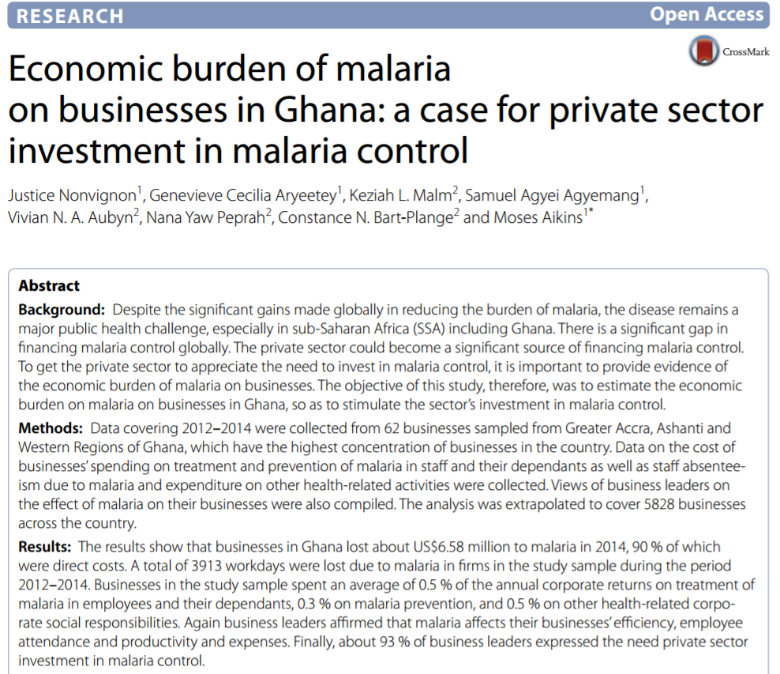
Economic Case for Private Sector Investment in Health
In Ghana, businesses lost approx.
US$6.5m in 2014 alone to malaria
3,913 workdays, equivalent of one month of staff productivity, lost to malaria 2012-2014
93% of business leaders think it is worthwhile for their businesses to invest in malaria control

Slide 20
Kenya Case
Genevieve C. Aryeetey, PhD
School of Public Health
University of, Ghana

Slide 21
Funding Gap

Slide 22
Funding Gap
KSH 52,281
KSH 43,231
KSH 41,015
KSH 21,027
KSH 50,009

Slide 23
Health Financing by Source

Slide 24
Fiscal Space

Slide 25
Improved Tax Revenue
Tax Revenue
Actual to Potential VAT revenue

Slide 26
Fiscal Space from Tax Revenue
Space from Tax Revenue
Broaden tax base
Enhance tax compliance: Automated Tax System (iTax)
Enhance VAT collection
Enhance property tax collection

Slide 27
Overseas Development Assistance
Significant declines expected due to
Transition to MIC status and
Global economic downturn

Slide 28
Borrowing
High fiscal discipline in Kenya, relative to Ghana.
Suggests a more sustainable public debt levels and low risk of debt distress.
This could be leveraged for fiscal space for the health sector.
Channeled to high priority public health areas

Slide 29
Improved Health Systems Efficiency
Enhancing Efficiency
Average efficiency estimated at 72.6%, 50.7%, and 43% for hospitals, health centers and dispensaries respectively.
Need to rationalize expenditure through curtailing of less productive expenditures

Slide 30
Improving Private Sector Investment
Public-private partnerships for health
PPP in delivery of specific services improves efficiency but also brings in private sector resources for health
Make an economic case for private sector to specifically invest in health

Slide 31
Concluding…..
Shortfall in funding health in Ghana and Kenya due to
Transition to LMIC
Global economic downturn
The gaps notwithstanding, there is potential to improve health financing through:
Improved tax revenue – expanding tax base
Improved efficiency
Public-private Partnerships & private sector contributions to health
Countries can reach convergence with improved financing and strengthening health systems
A conscious effort needed

Slide 32
Study Team
Justice Nonvignon, PhD, Senior Lecturer & Health Economist, School of Public Health, University of Ghana. Team Lead
Genevieve Cecilia Aryeetey, PhD, Lecturer & Health Economist, School of Public Health, University of Ghana.
Jacob Novignon, PhD, Lecturer & Health Economist, Department of Economics, Kwame Nkrumah University of Science & Technology, Kumasi, Ghana.
Kwakye Kontor, MSc, Health Economist, Ministry of Health, Ghana.
Selassi D’Almeida, MSc, Health Economics Advisor, World Health Organization, Ghana Country Office, Accra.
Bernadette Wanjala, PhD, Policy Analyst, Macroeconomics Division, Kenya Institute for Public Policy Research and Analysis, Nairobi, Kenya.
Elkana Nyakundi Ong’uti, MA, Chief Economist and Head, Division of Policy and Planning, Ministry of Health, Nairobi, Kenya.
The Commission on Investing in Health, University of California, San Francisco

Slide 33
Funded by:
African Health Economics and Policy Association (AfHEA) through a grant from Bill and Melinda Gates Foundation

